Slide 1


MIGRATION ASSESSMENT REPORT

Slide 2

Agenda
Executive Summary
Infrastructure Assessment
Application Assessment
Transformation Recommendations
Azure migration readiness
Q&A
2
Notes:
Think the dates are a mistake

Slide 3

Executive Summary
3
Notes:
Think the dates are a mistake

Slide 4
Executive Summary
Scope of the assessment:
25 systems assessed
25 Windows
0 Linux
5 Applications
3 Web Form (PHP 1, .Net 2)
2 Win Form (.Net)
4 Databases
SQL Server 2014
Method:
Deployed Azure Migrate, App CloudPilot
Resource consumption data collected from CPU, RAM, Storage and I/OPS Utilization
Data collected by Azure Migrate was proceeded through CloudRecon to generate economic analysis.
Data collected by App CloudPilot was proceeded through CloudPilot to generate economic analysis.
Critical Key Findings
Remediate Windows Servers which are no longer supported or at the end of Extended Support.
Plan for Windows Server 2012, SQL Server 2014 upcoming end of life events.
4

Slide 5
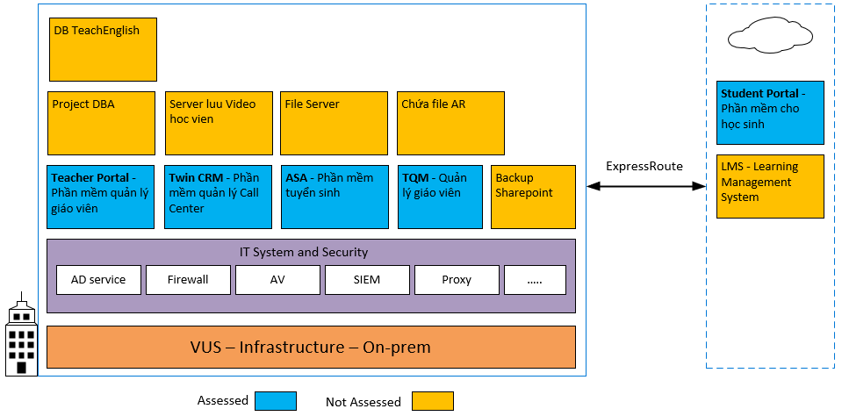
IT landscape
5

Slide 6
Infrastructure Assessment
6
Notes:
Think the dates are a mistake

Slide 7
Assessed 25 Servers
ComputerName | Server type | Application Name | CurrentOperatingSystem | Cores | SystemMemory(GB) | Storage(GB)
VUS-DBERP1-CL3.vus-etsc.edu.vn | Physical Server | DB KT, Dataware house | Microsoft Windows Server 2016 Standard | 16 | 255.873 | 10372
VUS-DBERP1-CL1.vus-etsc.edu.vn | Physical Server | DB Tuyển Sinh, TQM, HRT | Microsoft Windows Server 2016 Standard | 16 | 255.873 | 10884
VVHM00MS002.vus-etsc.edu.vn | Physical Server | File | Microsoft Windows Server 2016 Standard | 8 | 15.7402 | 8192
FIRE-SERVER.vus-etsc.edu.vn | Physical Server | Backup Sharepoint | Microsoft Windows Server 2012 R2 Standard | 4 | 7.9883 | 1280
VUS-BI-02 | Virtual Machine | ? | Windows Server 2016 Standard | 24 | 64 | 768
VUS-BI-01 | Virtual Machine | Service Tableau (Production) | Windows Server 2012 R2 Standard | 24 | 64 | 512
VUS-Unity-02 | Virtual Machine | DB cho các phần mềm core (UAT) | Windows Server 2016 Standard | 20 | 80 | 128
VUS-BI-UAT | Virtual Machine | DB WareHouse (UAT) | Windows Server 2016 Standard | 16 | 31.8125 | 512
VUS-TeacherPortal | Virtual Machine | Teacher Portal .NET, Quản lý thông tin giáo viên, lịch học | Windows Server 2016 Standard | 16 | 16 | 128
VUS Radius Server | Virtual Machine | Radius Wifi | Windows Server 2012 R2 Standard | 12 | 8 | 256
VUS-ADF | Virtual Machine | ? | Windows Server 2016 Standard | 12 | 24 | 256
VUS-File-02 | Virtual Machine | Chứa file AR | Windows Server 2012 R2 Standard | 8 | 8 | 128
VUS-Web-02 | Virtual Machine | Website Tuyển dụng HR, CV cho ứng viên HR, API cho phần mềm TWIN .PHP | Windows Server 2016 Standard | 8 | 8 | 128
VUS-DataAnalytic | Virtual Machine | Project DBA | Windows Server 2016 Standard | 8 | 32 | 512
VUS-File-03 | Virtual Machine | Update build cho cac phan mem, Quản lý Source Code | Windows Server 2012 R2 Standard | 8 | 8 | 128
VUS-OPENSOURCE | Virtual Machine | VUS-OPENSOURCE | Windows Server 2016 Standard | 8 | 16 | 256
VUS-WebService-01 | Virtual Machine | API cấp Invoice và job chạy cho các ứng dụng | Windows Server 2012 R2 Standard | 8 | 8.0039 | 128
VUS-MYSQLDB-01 | Virtual Machine | DB TeachEnglish | Windows Server 2016 Standard | 8 | 8 | 256
VUS-ServiceDesk | Virtual Machine | Dịch vu IT Service, Google | Windows Server 2016 Standard | 6 | 8 | 128
VUS-AAD-01 | Virtual Machine | Azure AD Connect | Windows Server 2016 Standard | 4 | 8 | 128
VUS-CRMApp | Virtual Machine | Phần mềm CRM Telemarketing | Windows Server 2016 Standard | 4 | 8 | 128
VUS-AD-02 | Virtual Machine | Secondary Domain Controller | Windows Server 2016 Standard | 4 | 8 | 128
VUS-AD-01 | Virtual Machine | Domain controller | Windows Server 2016 Standard | 4 | 16 | 1024
VUS-Analytic-02 | Virtual Machine | Project DBA | Windows Server 2016 Standard | 4 | 16 | 256
VUS-StudentVideo | Virtual Machine | Server luu Video hoc vien | Windows Server 2016 Standard | 4 | 16 | 1024
7

Slide 8
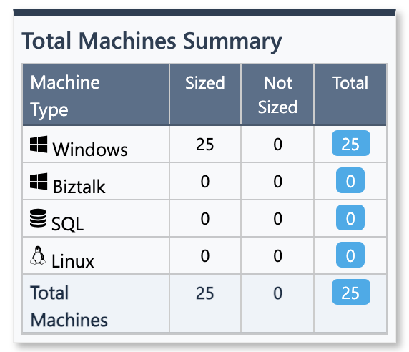
Performance & Utilization
Assessment 28 Machines (24 Virtual machine, 4 Physical Server)
Assessed Servers 25 Window, 3 Ignored Machines
19 Window server 2016, 6 Window server 2012
Total: 254 core, 991 Ram(GB), 37.64TB
Details of Ignored Machines
ComputerName | Platform | Details
PBXCallCenterN | virtual | Not Server
PBXOffice | virtual | Not Server
PBX-Database | virtual | Not Server
Assessed Servers
100%
Average CPU
100%
Average RAM
37.64TB
Total Storage
Resource Consumption
8

Slide 9
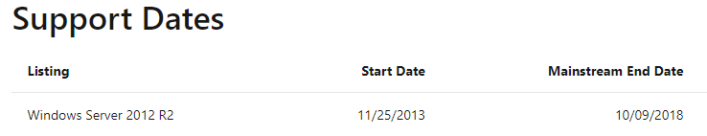
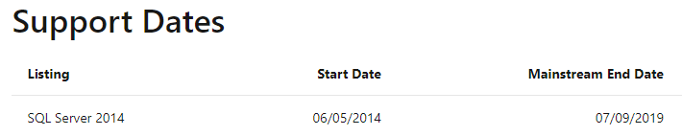
Windows Server 2012, SQL Server - No Longer Supported
https://docs.microsoft.com/en-us/lifecycle/products/windows-server-2012-r2
https://docs.microsoft.com/en-us/lifecycle/products/sql-server-2014
9

Slide 10
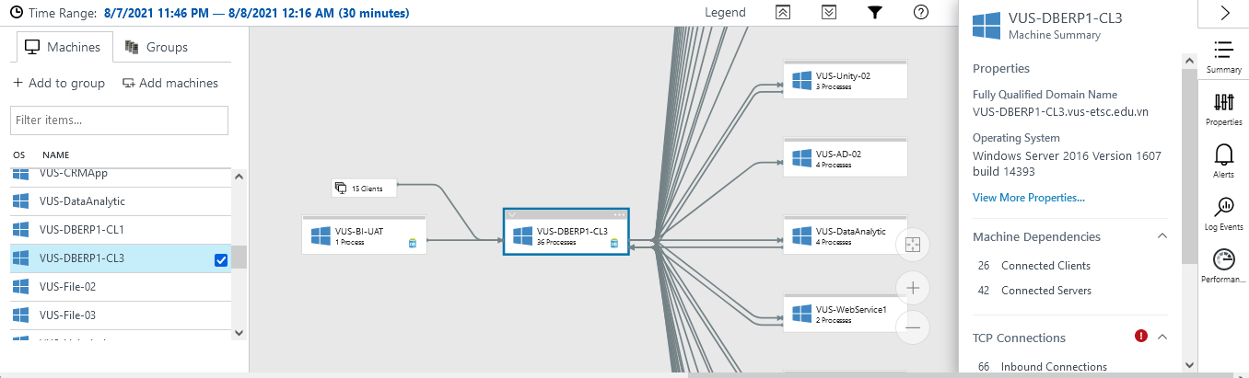
Service Map | Demo
10

Slide 11
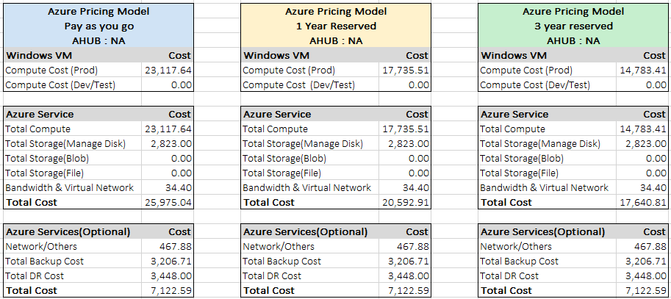
Current Environment | Lift and Shift ( As Is Configuration)
11

Slide 12
Current Environment | As is configuration Yearly Cost Comparison
Machine Type | Servers | PAY G | 1Y Reserved | 3Y Reserved
Windows | 25 | 277,411.68 | 212,826.12 | 177,400.92
12

Slide 13
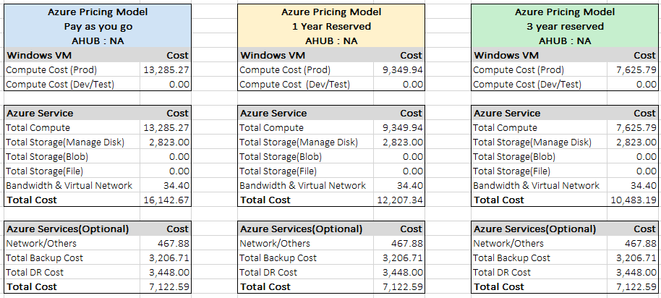
Current Environment on Azure | Optimized IaaS (Right Sized)
13

Slide 14
Current Environment | Optimized IaaS Yearly Cost Comparison
Machine Type | Servers | PAY G | 1Y Reserved | 3Y Reserved
Windows | 25 | 159,423.24 | 112,199.28 | 91,509.48
14

Slide 15
Business Case | IaaS (As is Configuration vs Right Sized)
15

Slide 16









Current Environment on Azure | Azure Landing Zone Cost Outline
Total Monthly Cost : $502.28
Key Vault | 5 HSM Key | 5.15
Application Gateway | 1 Instance | 103.02
Bandwidth | 250 GB | 29.40
Network Watcher | 1 Instance | 99.80
Express Route | 1 Instance | 100.00
Load Balancer | 2 Rules | 19.50
Virtual Network | 1 Instance | 5.00
IP Addresses | 2 IP Address | 5.86
Log Analytics | 25VMs | 134.55
16

Slide 17
TCO Cost Outline | On-Premise
Category | Description | 1 Year | 2 Year | 3 Year | 4 Year | 5 Year
Compute | Hardware | 50197.6 | 52707.48 | 55342.85 | 58109.99 | 61015.49
 | Hardware Maintenance Cost | 50197.6 | 52707.48 | 55342.85 | 58109.99 | 61015.49
 | Software (Linux) | 0 | 0 | 0 | 0 | 0
 | Software (Windows) | 6804 | 7144.2 | 7501.41 | 7876.48 | 8270.3
 | Biztalk | 0 | 0 | 0 | 0 | 0
 | Electricity | 14619.2 | 15350.16 | 16117.66 | 16923.55 | 17769.72
 | SQL License Cost | 0 | 0 | 0 | 0 | 0
 | SA(SQL) | 0 | 0 | 0 | 0 | 0
 | SA(Windows License) | 1701 | 1786.05 | 1875.35 | 1969.12 | 2067.57
 | SA(Linux License) | 0 | 0 | 0 | 0 | 0
 | Oracle License | 0 | 0 | 0 | 0 | 0
 | SA(Oracle) | 0 | 0 | 0 | 0 | 0
 | Virtualization Cost | 76428 | 80249.4 | 84261.87 | 88474.96 | 92898.71
Data Center | Cost Of DataCenter | 18438.41 | 19360.33 | 20328.34 | 21344.76 | 22412
Networking | Network hardware and software cost | 16335.03 | 17151.78 | 18009.37 | 18909.83 | 19855.33
 | Network maintenance cost | 2450.25 | 2572.76 | 2701.4 | 2836.47 | 2978.29
 | Service provider cost | 450 | 472.5 | 496.12 | 520.93 | 546.97
Storage | Storage hardware cost | 5112.99 | 5368.63 | 5637.07 | 5918.92 | 6214.87
 | Backup and Archive cost | 960 | 1008 | 1058.4 | 1111.32 | 1166.88
 | Storage Maintenance cost | 511.3 | 536.86 | 563.7 | 591.89 | 621.48
IT Labor | Cost of IT Labor | 9583.33 | 10062.49 | 10565.62 | 11093.9 | 11648.59
Total | Total Cost | 253788.71 | 266478.12 | 279802.01 | 293792.11 | 308481.69
17

Slide 18
TCO Cost Outline | All IaaS
Category | Description | 1 Year | 2 Year | 3 Year | 4 Year | 5 Year
Compute | Azure VM | 91509.47 | 96084.95 | 100889.2 | 105933.66 | 111230.34
 | Azure SQL VM | 0 | 0 | 0 | 0 | 0
 | Azure Linux VM | 0 | 0 | 0 | 0 | 0
 | BizTalk | 0 | 0 | 0 | 0 | 0
 | PostgreSQL(Oracle) | 0 | 0 | 0 | 0 | 0
 | Oracle License Cost | 0 | 0 | 0 | 0 | 0
 | Oracle SA(License) | 0 | 0 | 0 | 0 | 0
Data Center | Cost Of DataCenter | 0 | 0 | 0 | 0 | 0
Networking | Bandwidth | 352.79 | 370.43 | 388.96 | 408.41 | 428.83
 | Azure Advisor | 0 | 0 | 0 | 0 | 0
 | Azure Security Center | 4380 | 4599 | 4828.95 | 5070.39 | 5323.91
 | Azure Active Directory | 0 | 0 | 0 | 0 | 0
 | Application Gateway | 1236.24 | 1298.05 | 1362.95 | 1431.1 | 1502.65
 | Backup | 0 | 0 | 0 | 0 | 0
 | Traffic Manager | 0 | 0 | 0 | 0 | 0
 | Network Watcher | 1197.6 | 1257.48 | 1320.35 | 1386.37 | 1455.69
 | Loadbalancer | 234 | 245.7 | 257.98 | 270.88 | 284.42
 | Express Route | 1200 | 1260 | 1323 | 1389.15 | 1458.6
 | Virtual Network | 60 | 63 | 66.15 | 69.45 | 72.93
 | IP Addresses | 70.32 | 73.83 | 77.52 | 81.4 | 85.47
 | VPN Gateway | 0 | 0 | 0 | 0 | 0
 | Log Analytics | 1614.6 | 1695.33 | 1780.09 | 1869.1 | 1962.55
 | Key Vault | 61.8 | 64.89 | 68.13 | 71.54 | 75.11
Storage | Cost Of Managed Disk | 33876 | 35569.8 | 37348.29 | 39215.7 | 41176.48
 | Page blob storage cost | 4601.69 | 4831.77 | 5073.36 | 5327.03 | 5593.38
IT Labor | Cost of IT Labor | 9583.33 | 10062.49 | 10565.62 | 11093.9 | 11648.59
Total | Total Cost | 149977.84 | 157476.72 | 165350.55 | 173618.08 | 182298.95
18

Slide 19
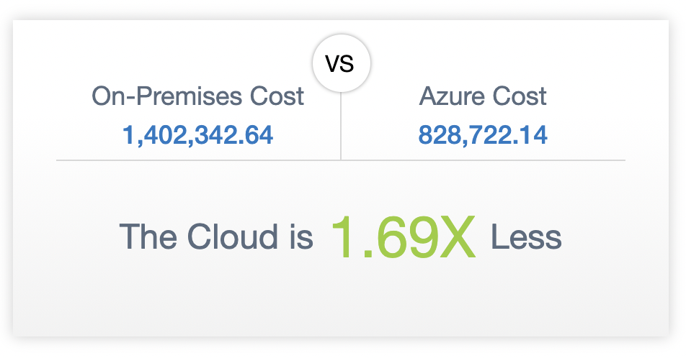
TCO Cost Outline | All IaaS
19

Slide 20
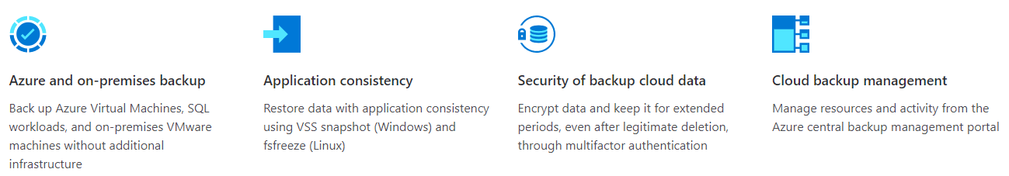
Azure Backup Services | On-premises to Cloud
Options below can be configured to meet retention needs
Local Redundant Storage (LRS)
Moderate daily churn
Daily Recovery Point retention for 31 days
Weekly Recovery Point retention for 4 weeks
Monthly Recovery Point retention for 1 months
Yearly Recovery Point retention for 1 year
Azure Backup
$3,206.71 USD per month
Environment : 25 Production instances Assumptions: Redundancy : LRS; Average Daily Churn : Low (Windows, Linux, Biztalk), Moderate(SQL) Retention Range of RPs : 30 Daily RPs (Days), 12 Weekly RPs (Weeks), 12 Monthly RPs (Months), 3 Yearly RPs (Years) Data Size : Used StorageX1.3
Recommendations
Shift existing backup process to Azure’s Backup Services to protect critical data currently on-premises.
20

Slide 21
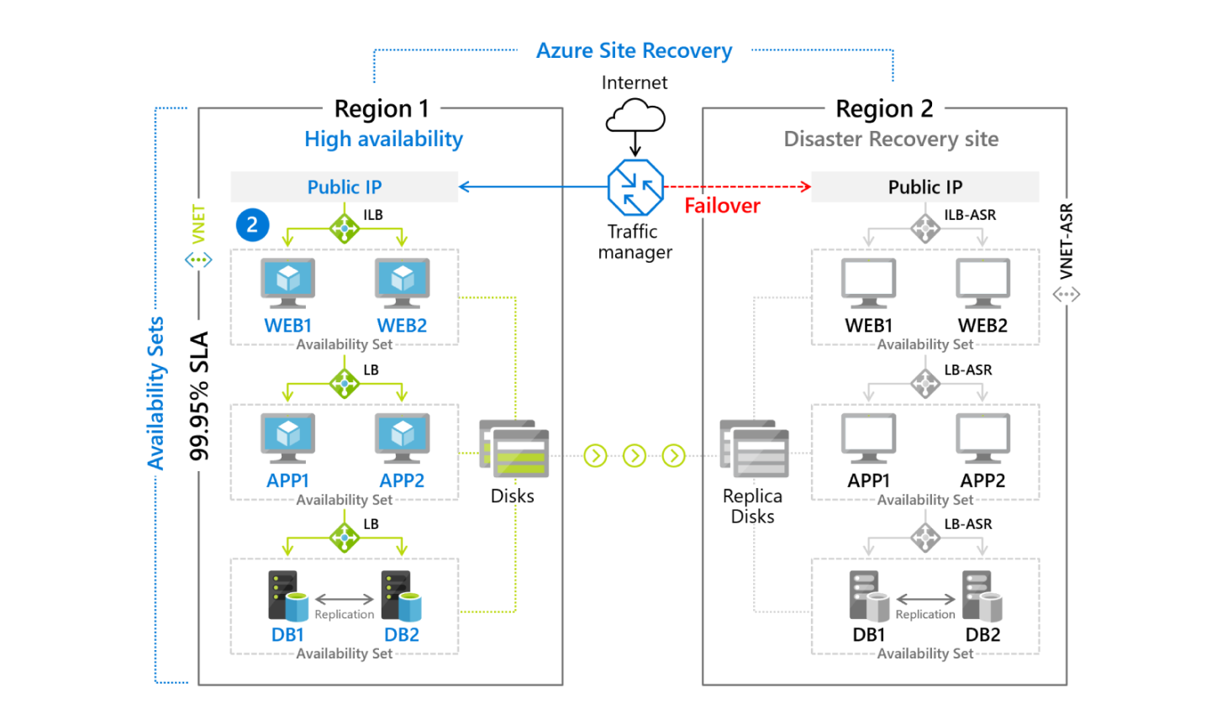
Azure Site Recovery
Azure Site Recovery monitors VMs and stores backups in Azure’s low-cost storage. When failover occurs, ASR automatically connects to the backups and spins up the recovery VMs.
Azure Site Recovery
$3,448.00 USD per month
Environment : 25 Production instances Assumptions: Redundancy : LRS; Average Daily Churn : Low (Windows, Linux, Biztalk), Moderate(SQL) Retention Range of RPs : 30 Daily RPs (Days), 12 Weekly RPs (Weeks), 12 Monthly RPs (Months), 3 Yearly RPs (Years) Data Size : Used StorageX1.3
Recommendations
Use Azure Site Recovery to minimize the costs of compute and licensing of active standby DR VMs. Use Azure Site Recovery Deployment Planner for Hyper-V to Azure Azure Site Recovery Deployment Planner for VMware disaster recovery - Azure Site Recovery | Microsoft Docs
21

Slide 22
Backup Recommendations
ComputerName | Server type | Application Name | Monthly Cost
VUS-DBERP1-CL3.vus-etsc.edu.vn | Physical Server | DB KT, Dataware house | 840.12
FIRE-SERVER.vus-etsc.edu.vn | Physical Server | Backup Sharepoint | 107.76
VUS-DBERP1-CL1.vus-etsc.edu.vn | Physical Server | DB Tuyển Sinh, TQM, HRT | 881.22
VVHM00MS002.vus-etsc.edu.vn | Physical Server | File | 667.68
VUS-File-02 | Virtual Machine | Chứa file AR | 17.78
VUS-BI-UAT | Virtual Machine | DB WareHouse (UAT) | 51.11
VUS-Web-02 | Virtual Machine | Website Tuyển dụng HR, CV cho ứng viên HR, API cho phần mềm TWIN .PHP | 17.78
VUS-DataAnalytic | Virtual Machine | Project DBA | 51.11
VUS-File-03 | Virtual Machine | Update build cho cac phan mem, Quản lý Source Code | 17.78
VUS-OPENSOURCE | Virtual Machine | VUS-OPENSOURCE | 25.55
VUS-WebService-01 | Virtual Machine | API cấp Invoice và job chạy cho các ứng dụng | 17.78
VUS-Analytic-02 | Virtual Machine | Project DBA | 25.55
VUS-StudentVideo | Virtual Machine | Server luu Video hoc vien | 92.21
VUS-MYSQLDB-01 | Virtual Machine | DB TeachEnglish | 25.55
Total ($) |  |  | 2839
22

Slide 23
Application Assessment
23
Notes:
Think the dates are a mistake

Slide 24
On-Prem Application | Impact and Readiness rating
In conjunction with Azure readiness, all applications were assessed with the customer for impact based on the following criteria:
Critical/non-critical
Windows and SQL Support
Customer priority
5 Applications have been identified as good candidates for phase 1:
Student Portal
Teacher Portal
TWIN-CRM
ASA
TQM
Application Name | # of Users | User Base | Application Server | Application Server IP | Development Language | Database Name | DR Priority | Database
Student Portal | 6000 | AD | uatserver.vus-etsc.edu.vn | 10.100.0.6 | PHP | vusmariadb | 1 | MariaDB
Teacher Portal | 100 | AD | vus-web-03.vus-etsc.edu.vn | 192.168.1.102 | ASP.NET | TEACHERPORTAL | 1 | SQL Database
TWIN CRM | 30 | AD | VUS-CRMApp.vus-etsc.edu.vn | 192.168.1.131 | C# | CRM | 1 | SQL Database
ASA | 50 | AD | win form | Client | C# | VUS_APP_0204 | 1 | SQL Database
TQM | 50 | AD | win form | Client | C# | TQM | 1 | SQL Database
24

Slide 25
Application Student Portal
Azure Cloud
25
Notes:
Think the dates are a mistake

Slide 26
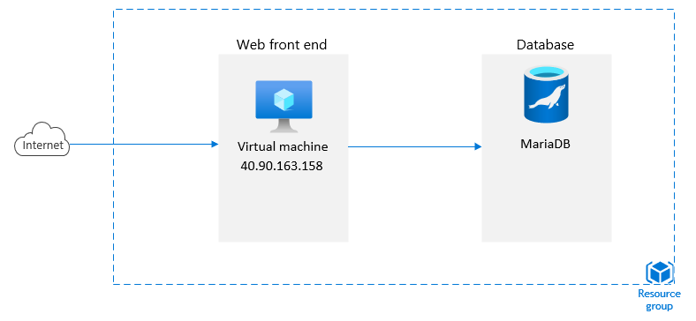
Current Architecture | App Student Portal -> Azure Cloud
26

Slide 27
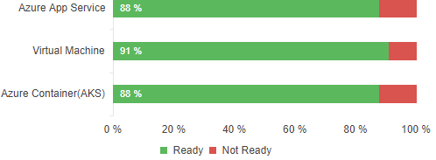
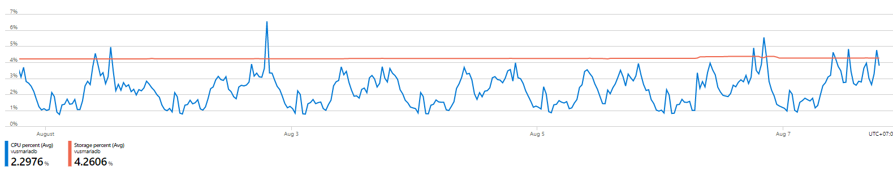
Findings | Student Portal
Application Details
General description: | Trang Portal để học viên xem thông tin của mỗi học viên, ngày giờ, buổi học,…
Critical/Non-critical? | Critical
App type | Lines of code | App Platform
Web Application | 103,653 | PHP
Database type | Server Edition | Size
Azure MariaDB | Version 10.3 | 4 vCores, 100GB Storage
Readiness Status
Readiness Status
Azure App Service
Azure Container (AKS)
Azure VM
In last 7 days:
- CPU percent: Avg 2.3%
- Storage percent: Avg 4.2%
S3 ($278.16)
DS5 v2 (2 Nodes) ($1849.04)
DS5 v2 ($1019.68)
Recommendation: Azure App Service enables you to build and host web apps and will auto-scale for high availability Cloud Pilot Recommendation
Why: Application is a good choice to move to Azure App, as it has no blockers & has additional features without any cost
27

Slide 28
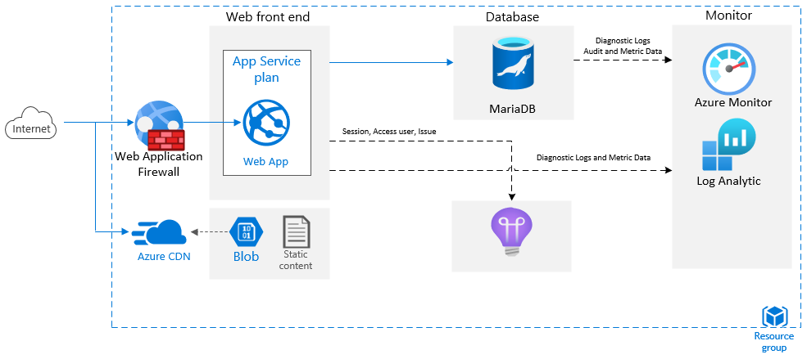
Azure Reference Architect | Student Portal
28

Slide 29
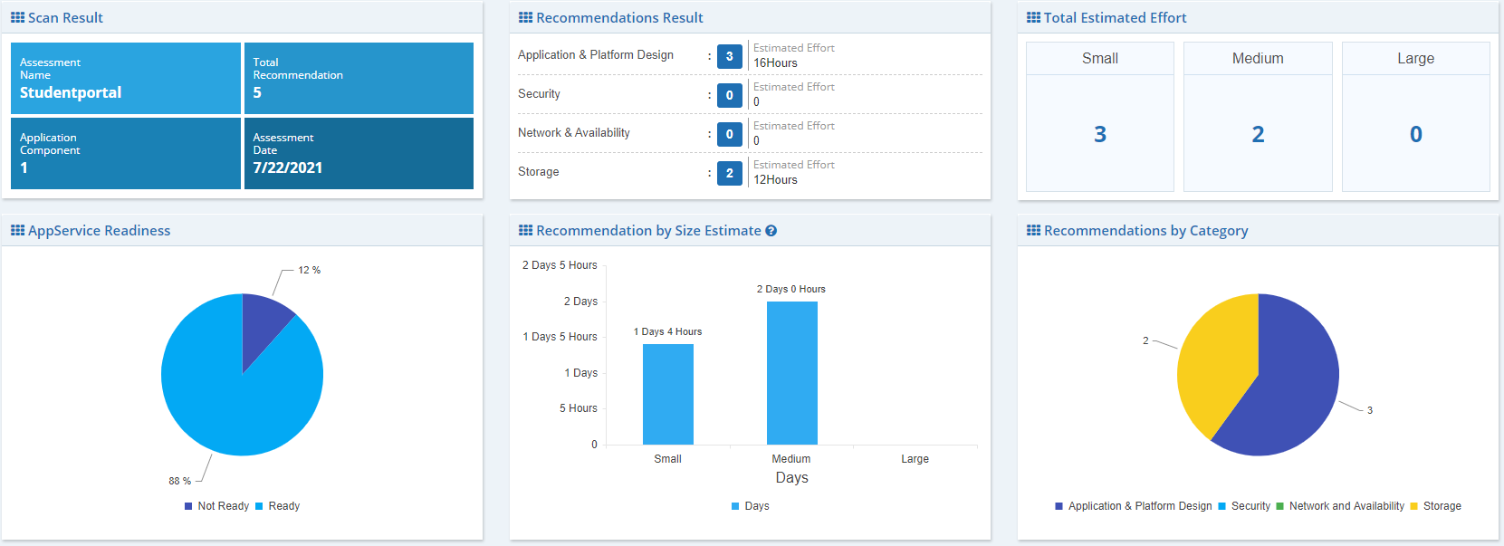
Application Readiness and Remediation Detail | Student Portal
29

Slide 30
Application Teacher Portal
30
Notes:
Think the dates are a mistake

Slide 31
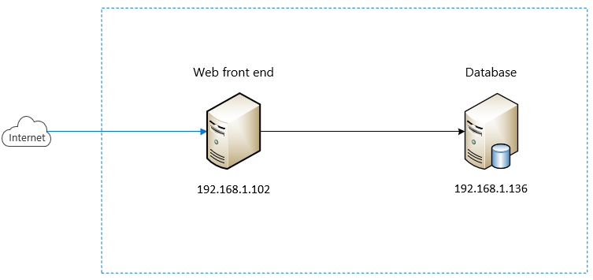
Current Architecture | App Teacher Portal -> Azure Cloud
31

Slide 32
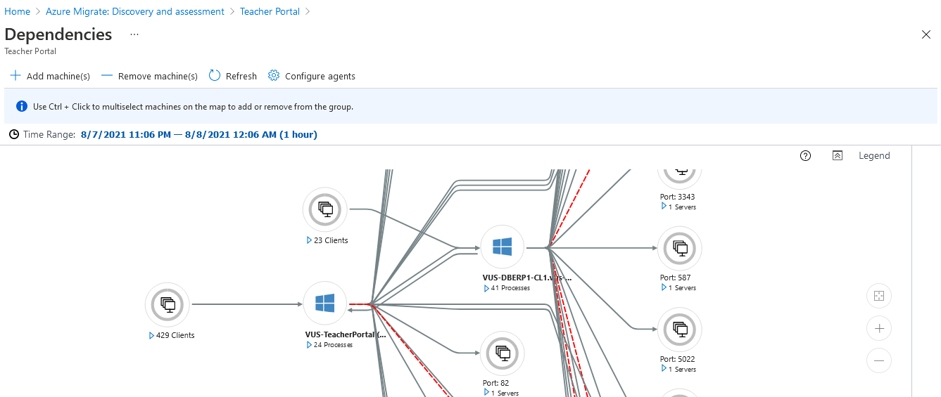
Dependencies | App Teacher Portal -> Demo
32

Slide 33
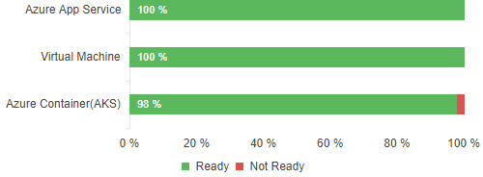
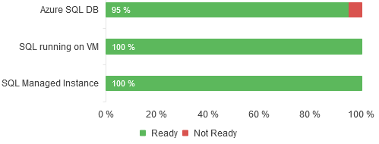
Findings | Teacher Portal
Application Details
General description: | Trang Portal để GV xem thông tin của buổi học, ca giờ, nội dung dạy.
Critical/Non-critical? | Critical
App type | Lines of code | App Platform
Web Application | 9,622 | PHP
Database type | Server Edition | Size
MSSQL | Enterprise Edition (64-bit) | ? GB
Readiness Status
Readiness Status
Azure App Service
Azure Container (AKS)
Azure VM
Azure SQL
SQL Managed Instance
Azure VM
S3 ($ 278.16)
DS5 v2 (2 Nodes) ($1849.04)
DS5 v2 ($1019.68)
Gen 5 4 vCore ($823.07)
4 vCore ($823.08)
D3 ($1569.41)
Recommendation: Azure App Service enables you to build and host web apps and will auto-scale for high availability Cloud Pilot Recommendation
Recommendation: SQL Managed Instance is a general-purpose relational database service that supports structures such as relational data, Cloud Pilot Recommendation
Why: Application is a good choice to move to Azure App, as it has no blockers & has additional features without any cost
Why: Highly scalable without downtown. Enables failover clustering
33

Slide 34
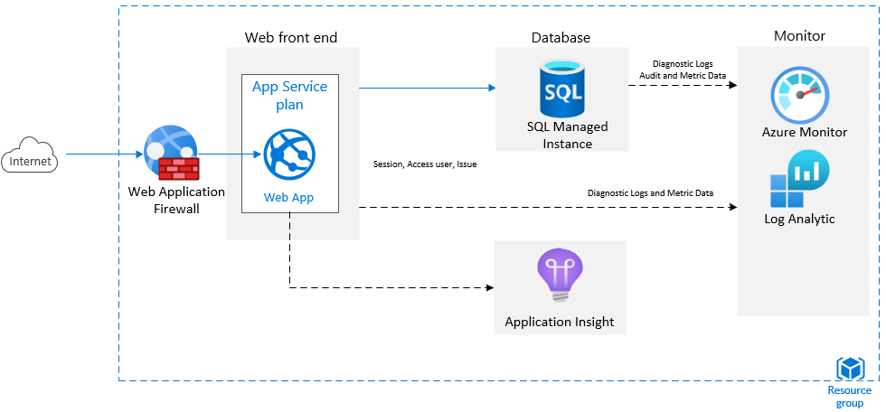
Azure Reference Architect | Teacher Portal
34

Slide 35
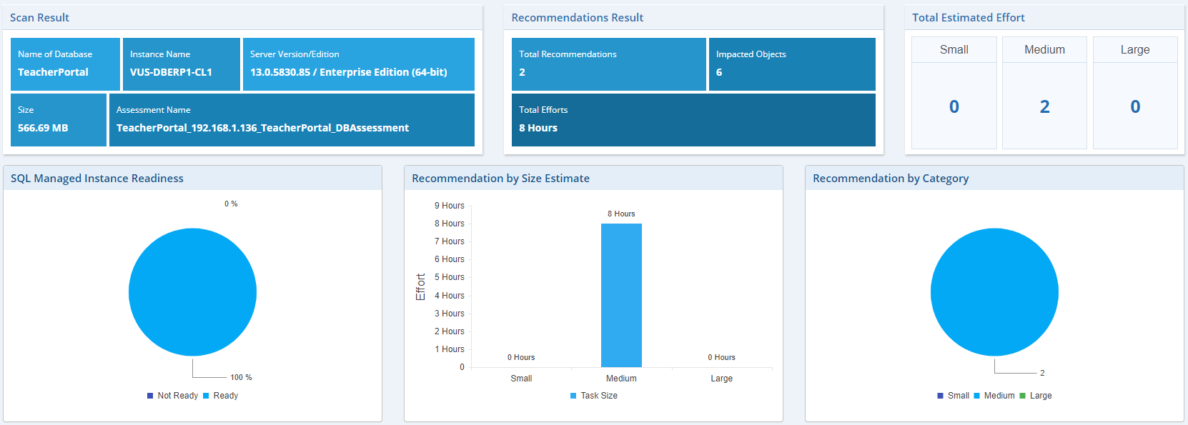
Database Readiness and Remediation Details | Teacher Portal
35

Slide 36
Application TWIN-CRM
36
Notes:
Think the dates are a mistake

Slide 37
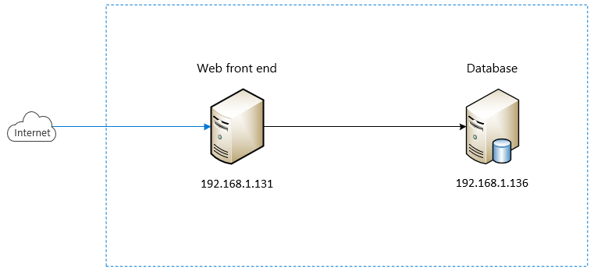
Current Architecture | App TWIN-CRM
37

Slide 38
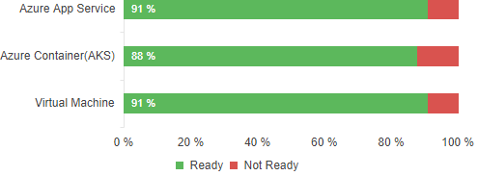
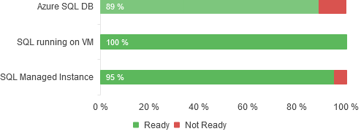
Findings | TWIN-CRM
Application Details
General description: | Lưu trữ thông tin về các đối tượng tiềm năng-dùng cho sell/marketing tiếp cận
Critical/Non-critical? | Critical
App type | Lines of code | App Platform
Web Application | 10,1963 | .Net
Database type | Server Edition | Size
MSSQL | Enterprise Edition (64-bit) | ? GB
Readiness Status
Readiness Status
Azure App Service
Azure Container (AKS)
Azure VM
Azure SQL
SQL Managed Instance
Azure VM
S3 ($292.80)
DS5 v2 (2 Nodes) ($1849.04)
DS13-4 v2 ($865.22)
Gen 5 4 vCore ($823.07)
4 vCore ($823.08)
D3 ($1569.41)
Recommendation: Azure App Service enables you to build and host web apps and will auto-scale for high availability Cloud Pilot Recommendation
Recommendation: SQL Managed Instance is a general-purpose relational database service that supports structures such as relational data, Cloud Pilot Recommendation
Why: Application is a good choice to move to Azure App, as it has no blockers & has additional features without any cost
Why: Highly scalable without downtown. Enables backup simple
38

Slide 39
Azure Reference Architect | TWIN-CRM
39

Slide 40
Application Winform ASA
40
Notes:
Think the dates are a mistake

Slide 41
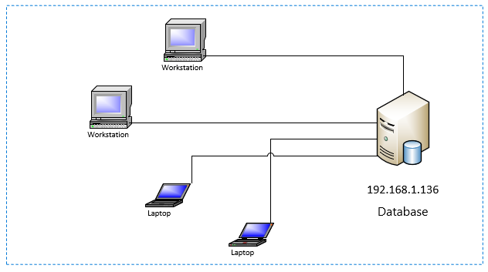
Current Architecture | Winform ASA
41

Slide 42
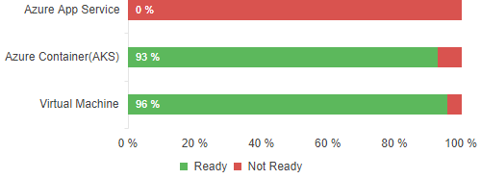
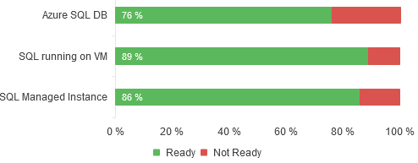
Findings | Winform ASA
Application Details
General description: | P/M lưu trữ thông tin học viên, lớp học, phòng học, khóa học, chương trình học và các cấp độ học.
Critical/Non-critical? | Critical
App type | Lines of code | App Platform
Web Application | 6,824 | .Net
Database type | Server Edition | Size
MSSQL | Enterprise Edition (64-bit) | ? GB
Readiness Status
Readiness Status
Azure App Service
Azure Container (AKS)
Azure Virtual Desktop
Azure SQL
SQL Managed Instance
Azure VM
N/A
DS3 v2 (2 Nodes) ($462.62)
F4s v2 ($3.116)
Gen 5 4 vCore ($823.07)
4 vCore ($823.08)
D3 ($1569.41)
Recommendation: Azure Virtual Desktop provides on-demand, high-scale, secure, virtualized infrastructure using Windows Server. Azure Container is not able to use
Recommendation: SQL Managed Instance is a general-purpose relational database service that supports structures such as relational data, JSON
Why: This Application can also move on Azure Virtual Desktop with minimal code change
Why: Highly scalable without downtown. Enable Failover clustering in minutes.
42

Slide 43
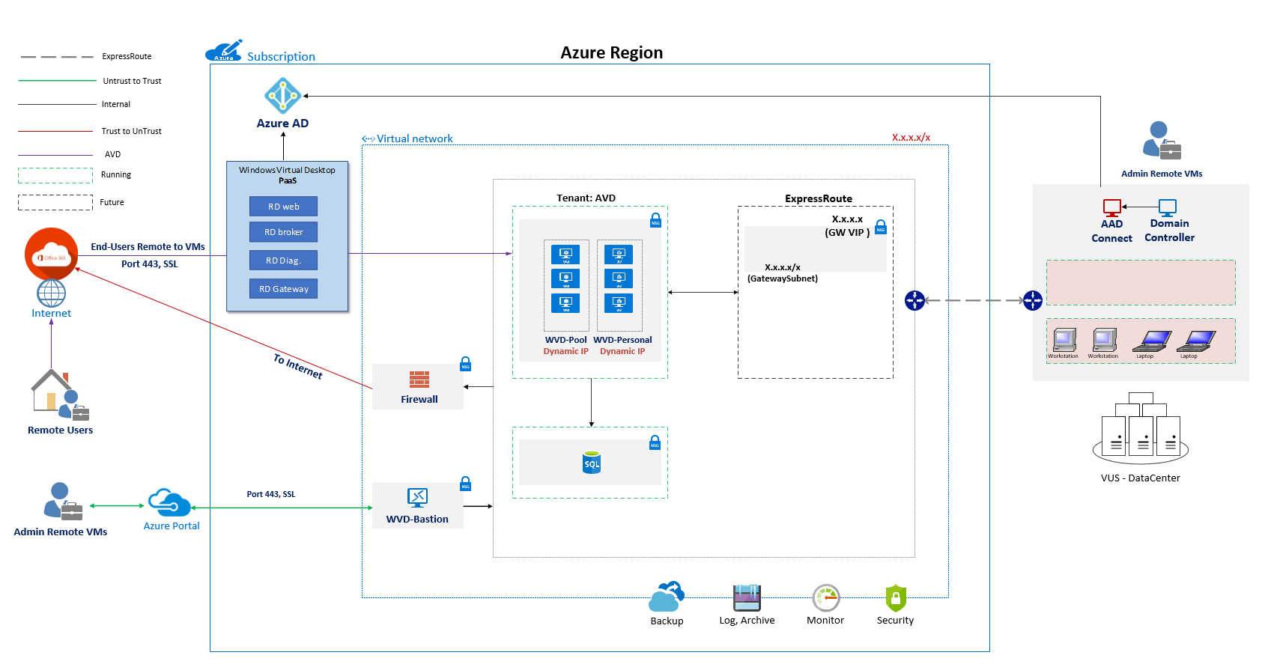
Azure Reference Architect | Winform ASA
43

Slide 44
Application TQM
44
Notes:
Think the dates are a mistake

Slide 45
Current Architecture | Winform TQM
45

Slide 46

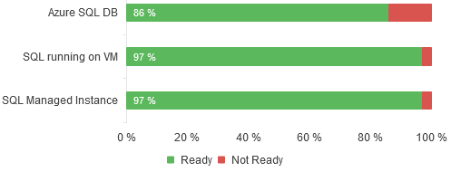
Findings | Winform TQM
Application Details
General description: | Lưu trữ thông tin GV, thời khóa biểu-lịch dạy.
Critical/Non-critical? | Critical
App type | Lines of code | App Platform
Web Application | 362 | .Net
Database type | Server Edition | Size
MSSQL | Enterprise Edition (64-bit) | ? GB
Readiness Status
Readiness Status
Azure App Service
Azure Container (AKS)
Azure Virtual Desktop
Azure SQL
SQL Managed Instance
Azure VM
N/A
DS3 v2 (2 Nodes) ( USD $ 462.62)
F4s v2 ($3.116)
Gen 5 4 vCore ( USD $ 823.07)
4 vCore ( USD $ 823.08)
D3 ( USD $ 1569.41)
Recommendation: Azure Windows Virtual Desktop provides on-demand, high-scale, secure, virtualized infrastructure using Windows Server
Recommendation: SQL Managed Instance is a general-purpose relational database service that supports structures such as relational data, JSON
Why: This Application can also move on Azure Virtual Machine with minimal code change
Why: Highly scalable without downtown. Enable Failover clustering in minutes.
46

Slide 47
Azure Reference Architect | Winform TQM
47

Slide 48
Azure Architecture Recommendation
48
Notes:
Think the dates are a mistake

Slide 49
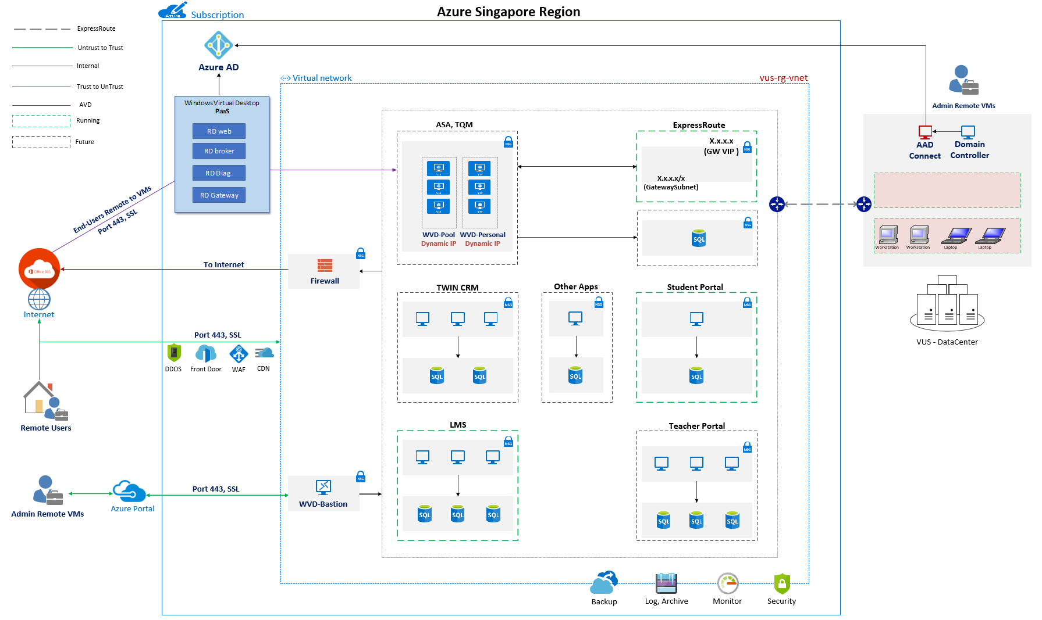

Slide 50
Recommendation
50
Notes:
Think the dates are a mistake

Slide 51
Transformation Recommendations
Quick win (1 months)
1
Apps Migration to WebApps
2
Azure monitor, Log Analytic, Application Insight
Quick Win
Short term
Long term
Azure Backup
3
DW
AI/ML
Short term (3 – 6 months)
Application
Insight
Azure
Virtual
Desktop
Apps
Modernization
1
Lift and Shift – Infrastructure Migration
App
Migration
Security
App Modernization (for new Application)
BCDR
2
Value
Monitoring
3
Monitoring (On Cloud & On Premise) – Azure Arc
Lift &
Shift
Long term (6 months)
Backup
Log
Analytics
1
Security End to End
2
Business Continuity – Disaster Recovery
Time
3
Azure Virtual Desktop
4
Data Warehouse, Data Analytic, Power BI
5
AI/ML, Chatbox
51

Slide 52
Detail Recommendations
Short term
Quick Win
Long term
Apps Migration to WebApps
Student Portal
Teacher Portal
TWIN-CRM
Azure monitor, Log Analytic
25 Servers
Application Insight
Student Portal
Teacher Portal
TWIN-CRM
Azure Backup
14 Servers Critical
Lift and Shift – Infrastructure Migration
14 Servers
App Modernization (for new Application)
ASA
TQM
Monitoring (On Cloud & On Premise) – Azure Arc
25 Servers
Optimize Usage & Improve Efficiency
Security End to End
Business Continuity – Disaster Recovery
Azure Virtual Desktop
Data Warehouse, Data Analytic, Power BI
AI/ML
Chatbox
52

Slide 53
Azure migration readiness
53
Notes:
Think the dates are a mistake

Slide 54
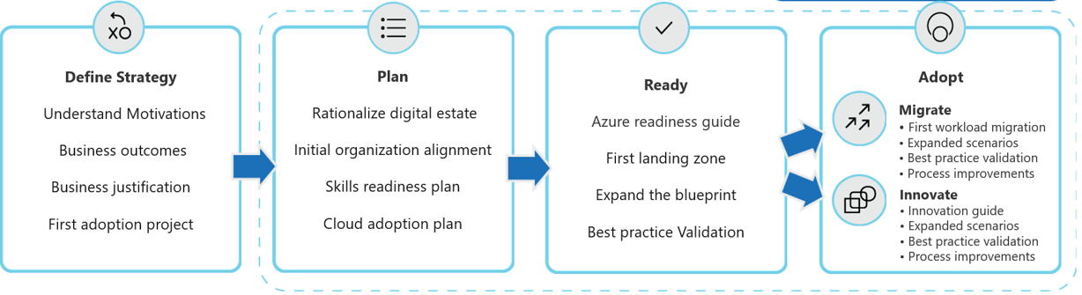
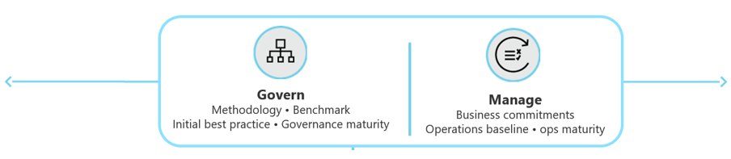
One Microsoft approach towards migration
Transformation based on Microsoft’s Cloud Adaption framework anchored from best practices and industry standards.
Find out more at https://docs.microsoft.com/en-us/azure/cloud-adoption-framework/overview
54

Slide 55
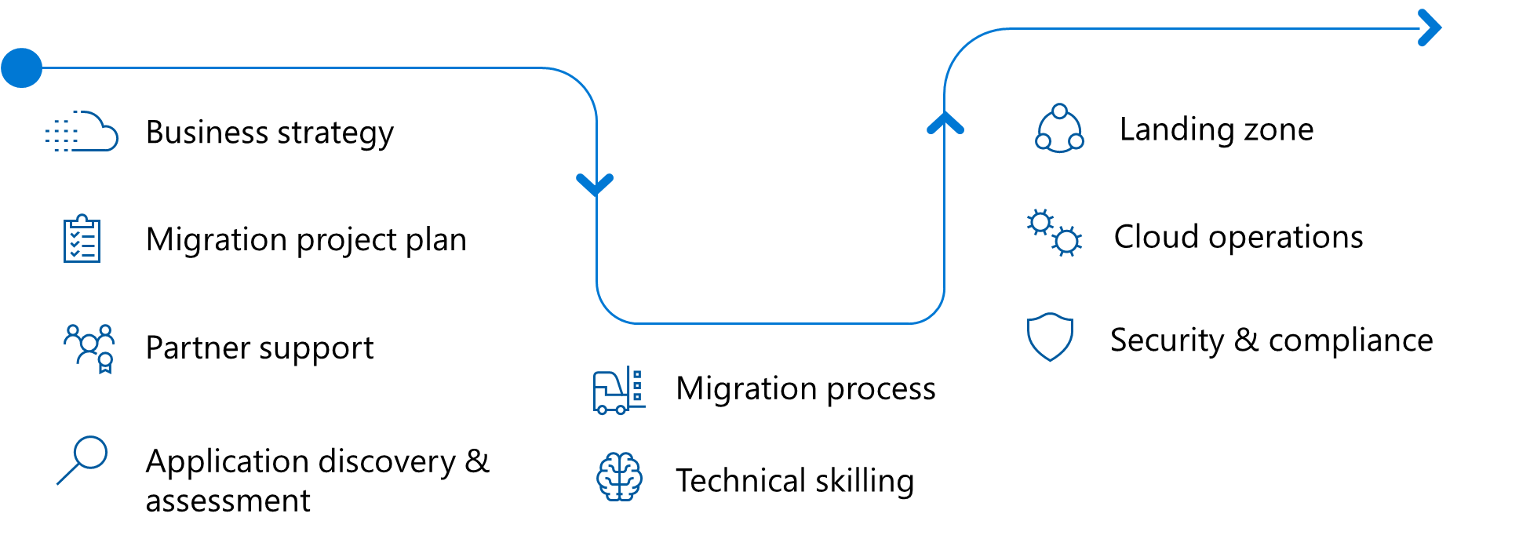
Azure migration readiness
Get ready for scale migration by addressing 9 different areas.
55

Slide 56
Q&A
56
Notes:
Think the dates are a mistake

Slide 57

57

